Slide 1
Mutations

Slide 2
Mutation
Sudden heritable change in the genetic material is called mutation
Chromosome level and/or individual gene
it is the ultimate source of genetic variation; it provides raw material for evolution

Slide 3
Somatic vs Germline
Somatic Mutations
Occur in cells of the body, excluding the germline
Affects subsequent somatic cell descendants
Not transmitted to offspring
Germline Mutations
Germline Mutations
Mutations that occur in the germline cells
Possibility of transmission to offspring
Mutations that occur in the germline cells
Possibility of transmission to offspring

Slide 4
Types of Mutations according to Cause:
1. Spontaneous Mutation
2. Induced Mutation

Slide 5
Spontaneous Mutation
The cause of a spontaneous mutation is unknown.
Spontaneous mutations result from DNA replication errors
  The rate is approximately 1 in10⁵ nucleotide pair

Slide 6
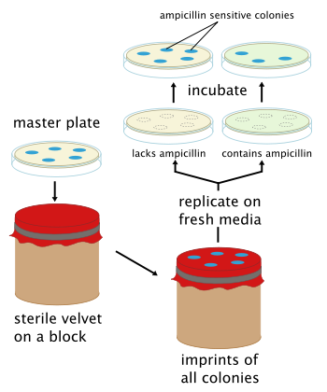
Random Or Directed by the Environment??
Replica plating
experiments by
Joshua Lederberg
& Esther Lederberg
in 1952

Slide 7
Phenotypic effect of mutations
The effect of mutation on the phenotype range from very minor alterations to gross modification of morphology to lethals.
Some base pair changes don’t change the protein product encoded resulting in isoalleles
Other mutations may result in total loss of activity of gene product

Slide 8
Conditional mutations
Mutations are lethals in one environment called the restrictive conditions
Viable under the permissive conditions
Ex. Temperature sensitive mutations
Paralytic is a gene in flies that codes for sodium channel

Slide 9
Auxotrophic mutants
Prototrophs= wildtype
Auxotrophs are mutants that deficient in synthesizing an essential metabolite (amino acid, purine, pyrimidine, vitamin etc)

Slide 10
Suppressor- sensitive
Suppressor sensitive mutant are viable when a second genetic factor, a suppressor, is present.
The suppressor gene mutant may correct or compensate for the defect caused by the primary mutant.

Slide 11
Induced Mutation
An induced mutation is brought about by a mutagen.
A mutagen is a physical agent or a chemical agent that causes an alteration of the base sequence of the DNA molecule.

Slide 12
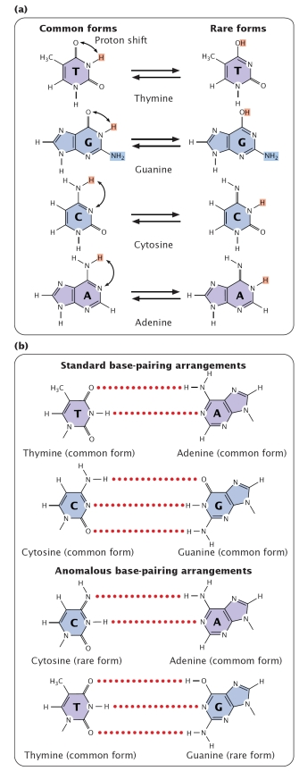
Molecular basis of mutation
Hydrogen atoms can fluctuate from amino group to N atom in both purines and pyrimidine. This is called tautomeric shift
2005 W. H. Freeman Pierce, Benjamin. Genetics:
A Conceptual Approach, 2nd ed. (New York:
W. H. Freeman and Company

Slide 13
Abnormal Base pairing

Slide 14
Transitions: Replacement of purine with other purine or pyrimidine with another pyrimidine (Can be explained by Tautomeric shift).
Transversion: Substitution of purine with pyrimidine or vice versa

Slide 15
Induced Mutations
Types of Mutagens :
Physical mutagens
  ultraviolet radiation
Chemical mutagens
  nitrous acid
  benzpyrenes
  aflatoxin
  base analogues

Slide 16
Ultraviolet Radiation
Ultraviolet radiation causes the formation of thymine dimers.
Thymine dimers block DNA replication.
Cell excises (cuts out) the thymine dimers using enzymes and repairs the damage.
A mutation occurs when the repair is faulty.

Slide 17
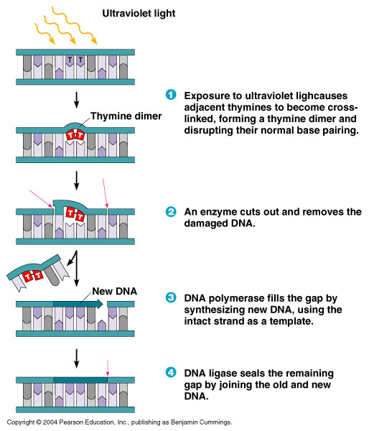

Slide 18
Alkylating Agents
Transfer alkyl groups to bases in the DNA as result their base pairing potential is altered & transitions results
EMS, nitrogen mustard etc

Slide 19
EMS mutagenesis:
It produces random mutations in genetic material by guanine alkylation.
This typically produces only point mutations.
The ethyl group of EMS reacts with guanine in DNA, forming the abnormal base O-6-ethylguanine
During DNA replication, DNA polymerases place thymine, instead of cytosine, opposite O-6-ethylguanine
the original G:C base pair becomes an A:T pair

Slide 20
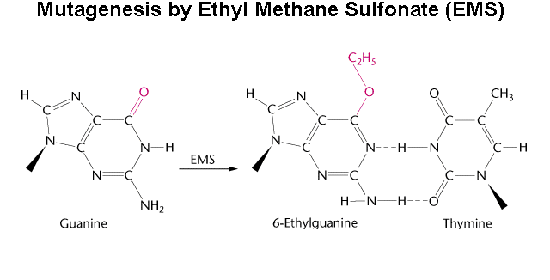
EMS mutagenesis: continued

Slide 21
Nitrous Acid
Bases that contain amino group (A,C) undergo oxidative deamination.
This alters the hydrogen bonding potential of the base.

Slide 22
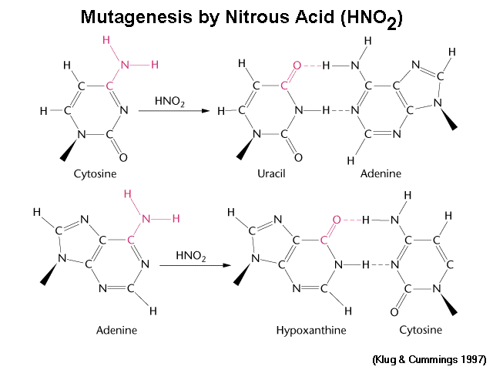

Slide 23
Base Analogs
Molecules that are structurally similar to the normal bases found in DNA.
Examples include:
  5-bromouracil acts as an analog of thymine.
  2-aminopurine acts as an analog of adenine.

Slide 24
Base Analogs
The base analogs can be inserted into DNA in place of the normal base.
When DNA replicates, the analog causes mistakes in base pairing, so a mutation results.

Slide 25
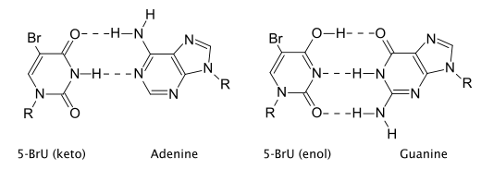
5 bromo Uracil
(common form)
(rare form)

Slide 26
Benzpyrene and Acridine
Acridine, Benzpyrene produce frameshift mutations so that one or more base pairs are inserted or deleted from the DNA when it replicates.

Slide 27
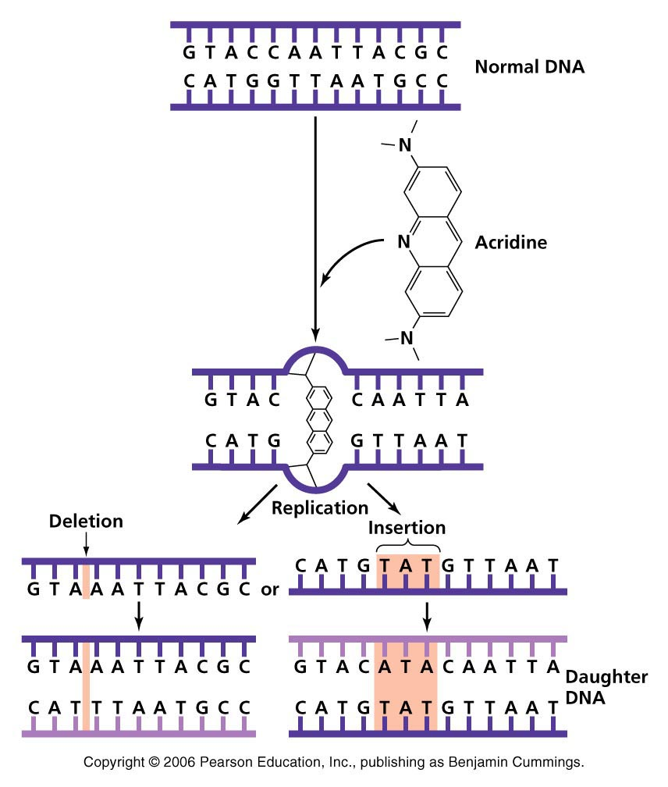
Acridine

Slide 28
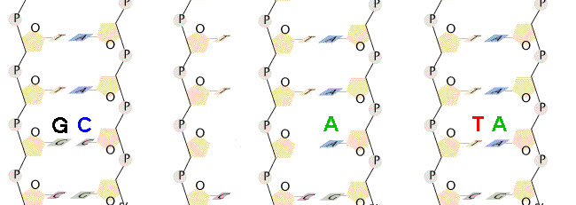
Depurination
depurination - loss of purine (A or G) base in intact polynucleotide produces an apurinic site. replacement of base may produce transversion
apyrimidinic sites are similar: loss of C or T

Slide 29
Types of Mutations according to Mechanism:
Missense Mutation --
  A missense mutation results from a base substitution on the DNA molecule and leads to the insertion of a different amino acid into the protein during translation.

Slide 30
Missense Mutation, cont.
The length of the gene is unchanged.
Therefore, the length of the final protein is unchanged from what was originally intended.
The “new” protein will have a different function from what was originally intended or it may have no function at all.

Slide 31
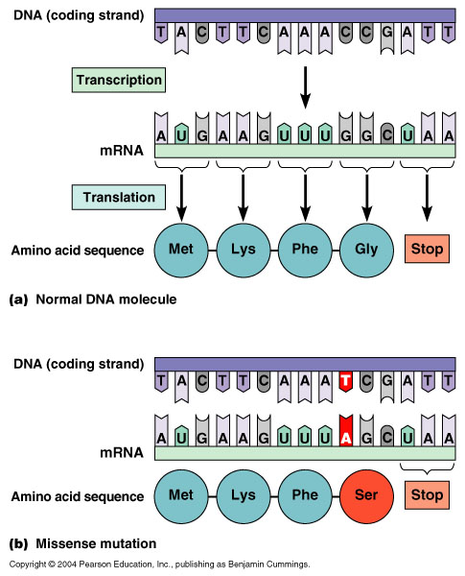

Slide 33
Nonsense Mutation --
  A nonsense mutation results form a base substitution on the DNA molecule and leads to the “premature” termination of protein synthesis during translation.

Slide 34
Nonsense Mutation, cont.
The length of the gene is unchanged.
The outcome is either no protein or an incomplete, nonfunctional protein.
The end result of a nonsense mutation is a loss of function or the loss of a characteristic.

Slide 35
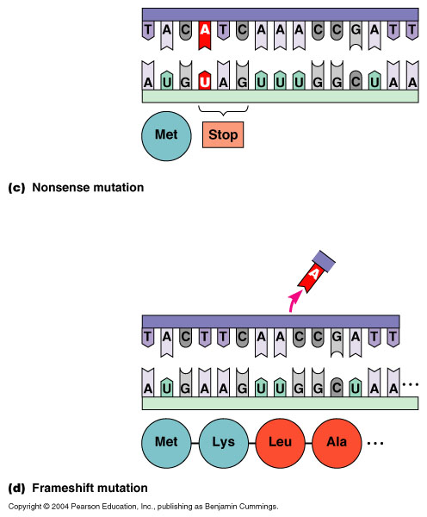

Slide 36
Frameshift Mutation --
  A frameshift mutation results form a base addition or base deletion on the DNA molecule and leads to either a missense type of outcome or a nonsense type of outcome during translation.

Slide 37
Frameshift Mutation, cont.
The length of the gene is changed.
The outcome is either an altered protein (the missense outcome) or no protein (the nonsense outcome).
The name (frameshift) stems from the shift in the reading frame (of the m-RNA) due to the altered gene length.

Slide 38
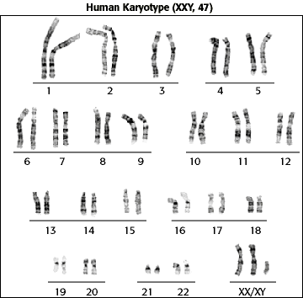
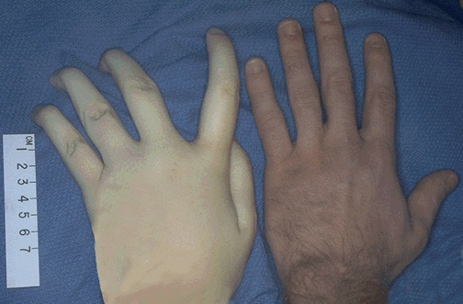
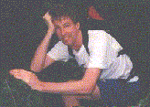

Klinefelter Syndrome
1 in 1,100 births
47 chromosomes
XXY only
#23 Trisomy
Nondisjunction
Scarce beard
Longer fingers and arms
Sterile
Delicate skin
Low mental ability
Normal lifespan

Slide 39
Structural Abnormality

Slide 40
Chromosomal Disorders
Chromosomal deletion: Portions of the chromosome are lost.
Chromosomal inversion: parts of the chromosome are flipped.
Chromosomal translocation:, parts of the chromosomes stick together and switch.

Slide 41
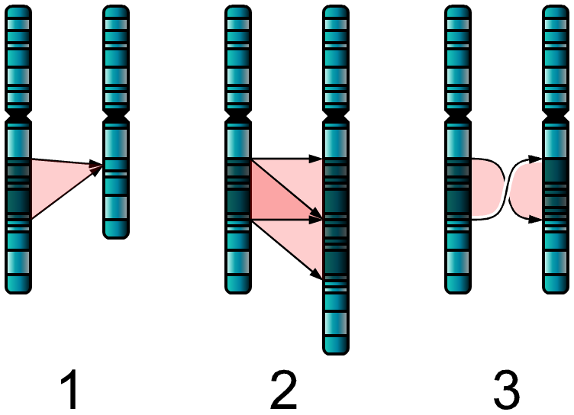
Single Chromosome Disorders
Deletion
Genetic material is missing
2. Duplication
Genetic material is present twice
3. Inversion
Genetic material is “flipped”

Slide 42
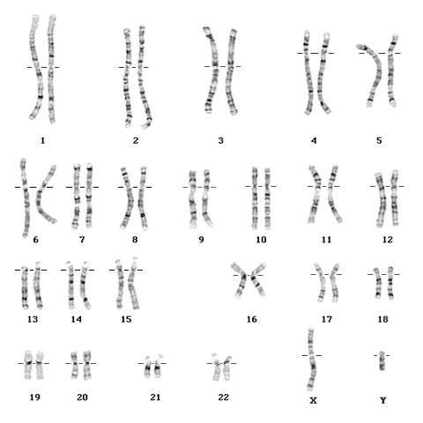
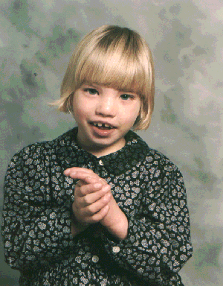
Cri-Du-Chat Syndrome
Deletion
1 in 216,000 births
46 chromosomes
#5 Deletion of lower
arm
Symptoms:
Moon-shaped face
Heart disease
Mentally retarded
Malformed larynx
Normal lifespan

Slide 43
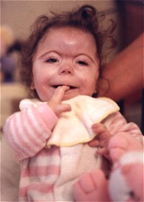
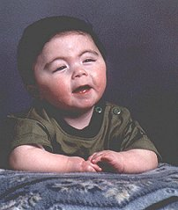
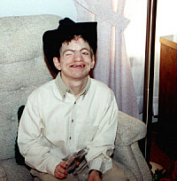
Thirteen Q Deletion Syndrome
1 in 500,000 births
46 chromosomes
XY or XX
#13 Deletion of lower arm
Mentally retarded
Deformed face
No thumbs
Heart disease
Short lifespan

Slide 44
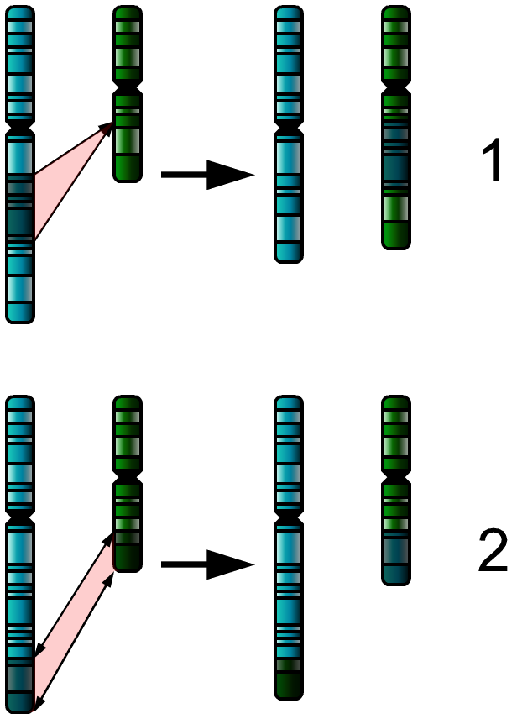
Two Chromosome Disorders
(Both types are called “translocation”)
Insertion
Genetic material is added from another chromosome
Translocation
Material is swapped with another chromosome

Slide 45
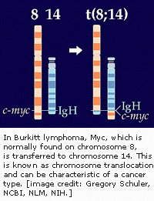
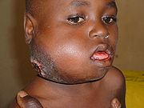
Burkitt Lymphoma (translocation)
Translocation of the Myc gene on chromosome 8
Normal Myc genes control cell growth and division
Translocated Myc genes don’t function properly
Leads to cancer of the lymph nodes

Slide 46
Acute Promyelocytic Leukemia
t(15,17)(q22,q12)
PML
q12
PML
q22
RARa
RARa
#15
#17
Chromosome

